Slide 1
Pacing
Objective: To understand how much time you have to complete each question on the Keystone Exam.

Slide 2
An expression is shown below:
For which value of x should the expression be further simplified?
6
21
23
36

Slide 3
2. A hockey team offers box seats for $39 each and regular seats for $18 each. The team presold 152 box seats and 69 regular seats. Which is closest estimate of how much the team made in presales?
$7,400
$9,200
$10,400
$13,200

Slide 4
3. A salesman earns a base salary of $3,000 plus $150 for each sale he makes. Last month he earned $6,750. Which equation could be used to find s, the number of sales he made last month?

Slide 5
4. When the expression
is factored completely, which is one its factors?

Slide 6
5. At a football game, Jerry purchased x hotdogs and y drinks. He spent a total of $28. The equation below represents the relationship between the number of hotdogs and drinks purchased.
The ordered pair represents the solution of the equation. What does the solution represent?
Hotdogs cost $4 and drinks cost $2.
Jerry purchased 4 drinks and 2 hotdogs.
Jerry spent $4 on hotdogs and $2 on drinks.
Jerry purchased 4 hotdogs and 2 drinks.

Slide 7
6. Which of the following inequalities is true for all real values of x?

Slide 8
7. Which of the following sets of ordered pairs is not a function?
{(1,2), (2,3), (3,4), (4,5)}
{(1,4), (3,7), (5,2), (8,5)}
{(3,2), (4,6), (7,2), (1,8)}
{(2,3), (3,2), (2,6), (6,5)}

Slide 9
8. A pizza shop charges for pizzas and adds a delivery fee. The cost (c), in dollars, to have any number of pizzas (p) delivered to a home is described by the function . Which statement is true?
The cost of 17 pizzas $19.
The cost of 2 pizzas is $17.
Each pizza costs $2 and the delivery fee is $17.
Each pizza costs $17 and the delivery fee is $2.

Slide 10
9. A bakery sells cakes. The amount charged for a cake (c) is $30 plus an additional charge for each color (d) used to decorate the cake, as shown in the equation below.
What does the number 2 represent in the equation?
The cost of an undecorated cake.
The number of colors used on the cake.
The additional cost for each color used on the cake.
The cost of the cake decorated with one color.

Slide 11
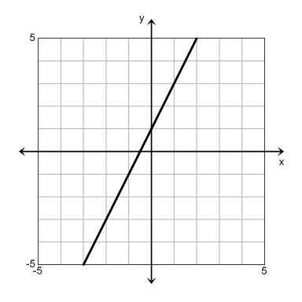
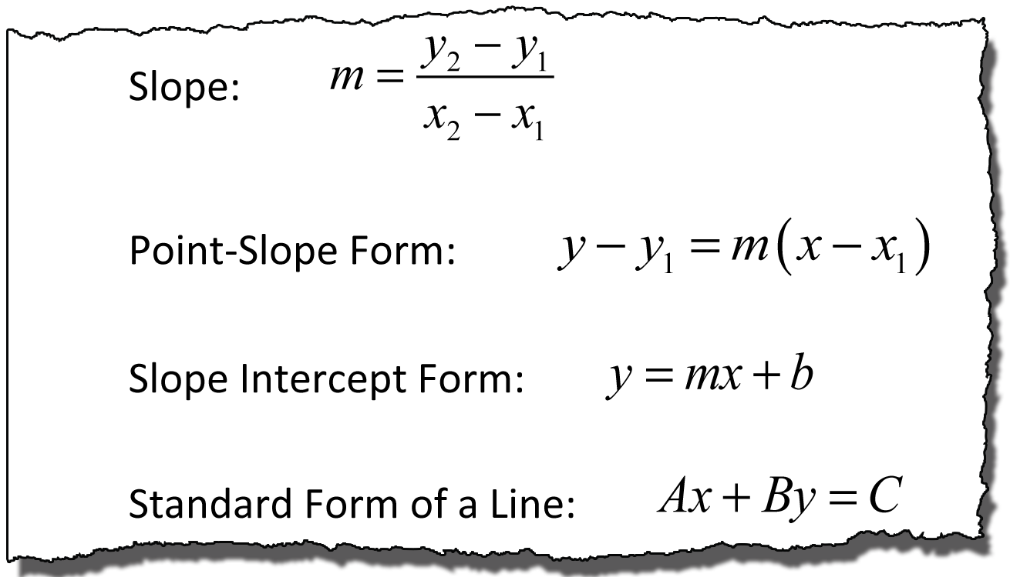
10. A graph of a linear equation is shown below. Which equation represents the graph?

Slide 12
11. A student’s SAT scores are listed below.
1090 1125 1160 1195 1230
The scores follow a pattern. If the pattern continues, which expression can be used to determine the student’s scores after n attempts?
35n + 1055
35(n + 1090)
1055n + 35
1090n

Slide 13
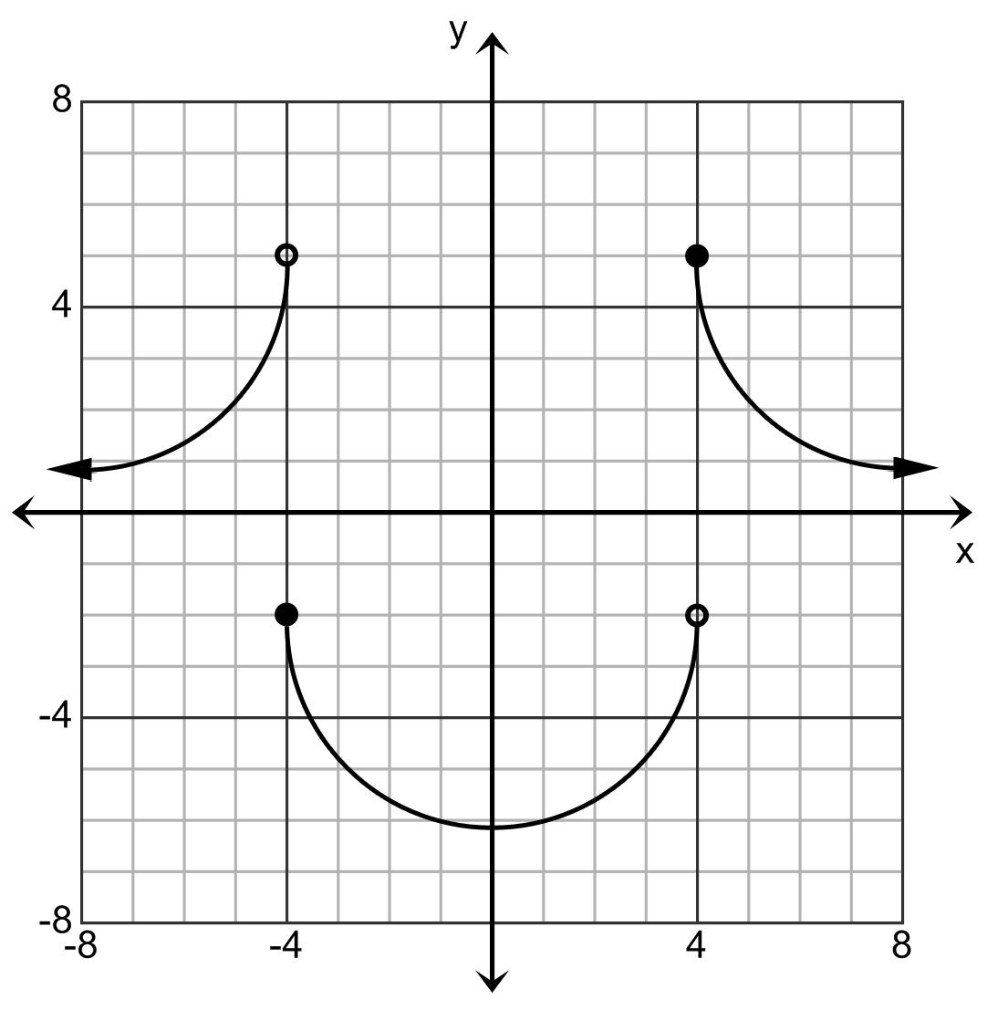
12. Which value is not in the range of the function?
-4
0
1
2

Slide 14
13. The table below shows values of y as a function of x.
Which linear equation best describes the relationship between x and y?
x | y
0 | 2
1 | 5
2 | 8
3 | 11

Slide 15
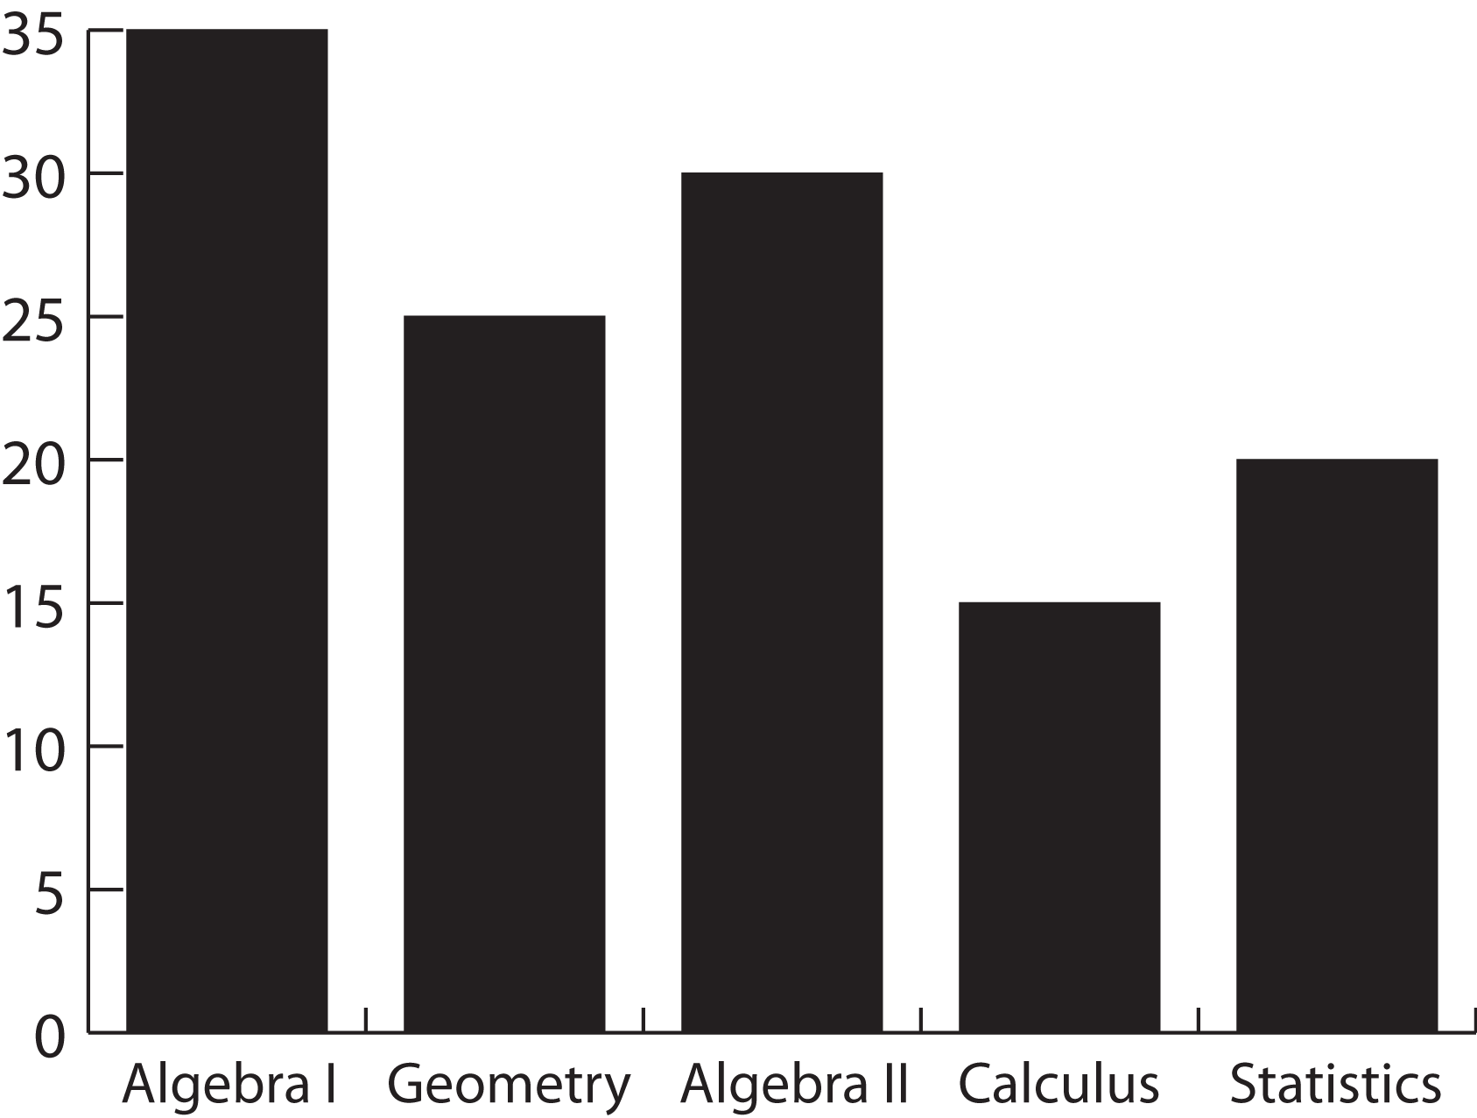
14. The bar graph below represents students’ favorite math classes. How many more students prefer Geometry over Statistics?
5
10
20
25

Slide 16
15. The box-and-whisker plot below represents the raw scores on an Algebra test.
Which of the following statements is true?
Approximately 25% of the scores are between 10.5 and 18.
Approximately 25% of the scores are between 7 and 18.
Approximately 70% of the scores are between 7 and 18.
Approximately 50% of the scores are
between 3 and 7.

Slide 17
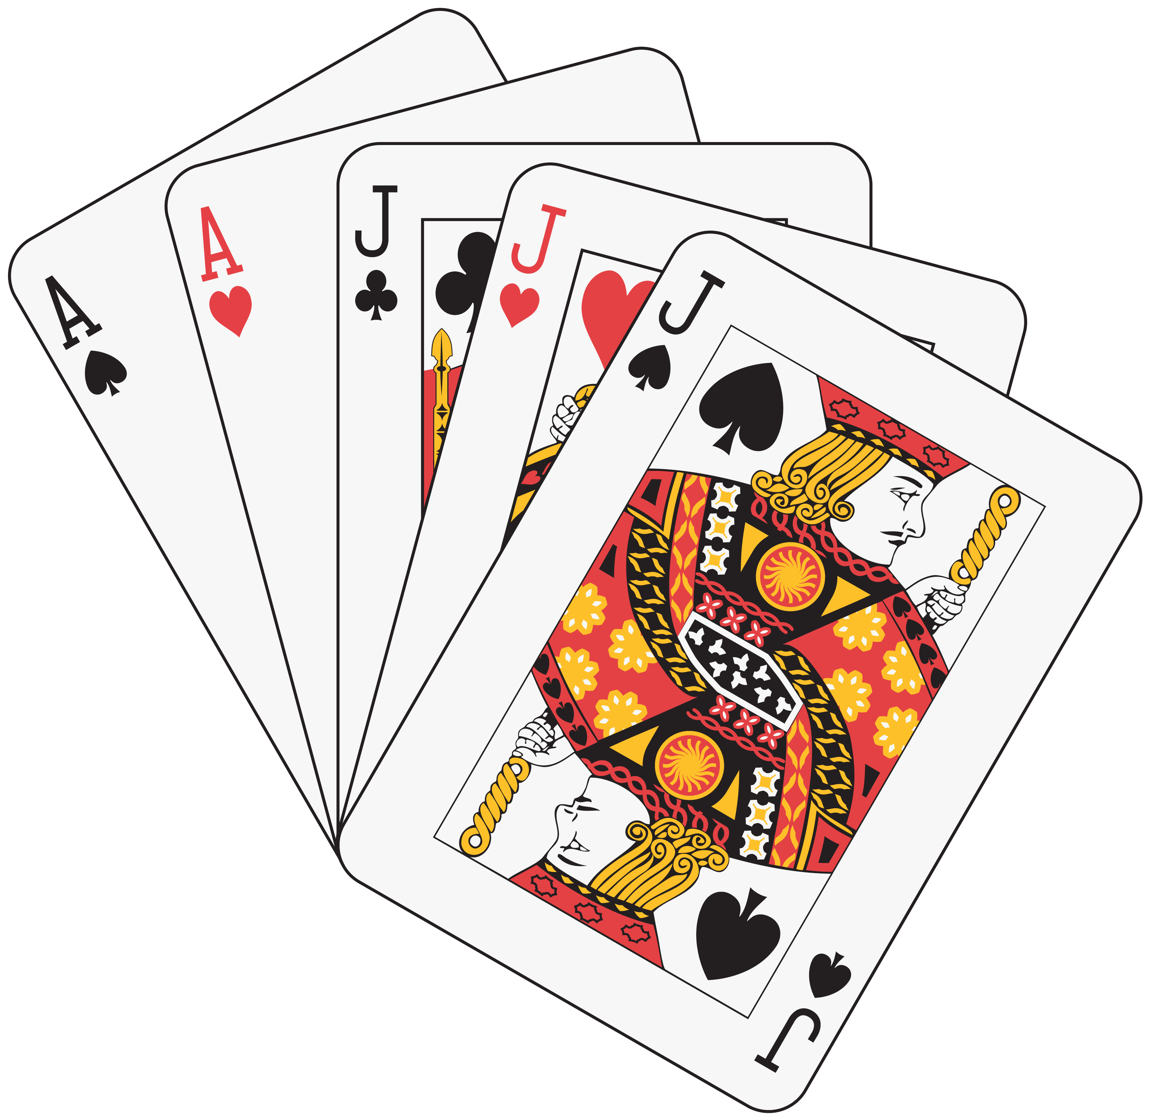
16. What is the probability that Leah randomly chooses an Ace, replaces it, and then a Jack from the cards shown below.
10%
24%
30%
50%

Slide 18
Two monomials are shown below.
What is the greatest common factor (GCF) of these monomials?

Slide 19
18. The length of each edge of a cube is doubled. By what factor is the volume of the cube increased?
2
6
8
24

Slide 20
19. Which value is closest to the square root of 260?
16.1
130
520
67,600

Slide 21
20. The ordered pairs below represent a function.
{(2,6), (3,7), (4,8), (5,9)}
What is the domain of the function?
{8, 10, 12, 14}
{(6,2), (7,3), (8,4), (9,5)}
{6, 7, 8, 9}
{2, 3, 4, 5}

Slide 22
Pacing Exercise Answers

Slide 23
An expression is shown below:
For which value of x should the expression be further simplified?
6
21
23
36

Slide 24
2. A hockey team offers box seats for $39 each and regular seats for $18 each. The team presold 152 box seats and 69 regular seats. Which is closest estimate of how much the team made in presales?
$7,400
$9,200
$10,400
$13,200

Slide 25
3. A salesman earns a base salary of $3,000 plus $150 for each sale he makes. Last month he earned $6,750. Which equation could be used to find s, the number of sales he made last month?

Slide 26
4. When the expression
is factored completely, which is one its factors?

Slide 27
5. At a football game, Jerry purchased x hotdogs and y drinks. He spent a total of $28. The equation below represents the relationship between the number of hotdogs and drinks purchased.
The ordered pair represents the solution of the equation. What does the solution represent?
Hotdogs cost $4 and drinks cost $2.
Jerry purchased 4 drinks and 2 hotdogs.
Jerry spent $4 on hotdogs and $2 on drinks.
Jerry purchased 4 hotdogs and 2 drinks.

Slide 28
6. Which of the following inequalities is true for all real values of x?

Slide 29
7. Which of the following sets of ordered pairs is not a function?
{(1,2), (2,3), (3,4), (4,5)}
{(1,4), (3,7), (5,2), (8,5)}
{(3,2), (4,6), (7,2), (1,8)}
{(2,3), (3,2), (2,6), (6,5)}

Slide 30
8. A pizza shop charges for pizzas and adds a delivery fee. The cost (c), in dollars, to have any number of pizzas (p) delivered to a home is described by the function . Which statement is true?
The cost of 17 pizzas $19.
The cost of 2 pizzas is $17.
Each pizza costs $2 and the delivery fee is $17.
Each pizza costs $17 and the delivery fee is $2.

Slide 31
9. A bakery sells cakes. The amount charged for a cake (c) is $30 plus an additional charge for each color (d) used to decorate the cake, as shown in the equation below.
What does the number 2 represent in the equation?
The cost of an undecorated cake.
The number of colors used on the cake.
The additional cost for each color used on the cake.
The cost of the cake decorated with one color.

Slide 32
10. A graph of a linear equation is shown below. Which equation represents the graph?

Slide 33
11. A student’s SAT scores are listed below.
1090 1125 1160 1195 1230
The scores follow a pattern. If the pattern continues, which expression can be used to determine the student’s scores after n attempts?
35n + 1055
35(n + 1090)
1055n + 35
1090n

Slide 34
12. Which value is not in the range of the function?
-4
0
1
2

Slide 35
13. The table below shows values of y as a function of x.
Which linear equation best describes the relationship between x and y?
x | y
0 | 2
1 | 5
2 | 8
3 | 11

Slide 36
14. The bar graph below represents students’ favorite math classes. How many more students prefer Geometry over Statistics?
5
10
20
25

Slide 37
15. The box-and-whisker plot below represents the raw scores on an Algebra test.
Which of the following statements is true?
Approximately 25% of the scores are between 10.5 and 18.
Approximately 25% of the scores are between 7 and 18.
Approximately 70% of the scores are between 7 and 18.
Approximately 50% of the scores are
between 3 and 7.

Slide 38
16. What is the probability that Leah randomly chooses an Ace, replaces it, and then a Jack from the cards shown below.
10%
24%
30%
50%

Slide 39
Two monomials are shown below.
What is the greatest common factor (GCF) of these monomials?

Slide 40
18. The length of each edge of a cube is doubled. By what factor is the volume of the cube increased?
2
6
8
24

Slide 41
19. Which value is closest to the square root of 260?
16.1
130
520
67,600

Slide 42
20. The ordered pairs below represent a function.
{(2,6), (3,7), (4,8), (5,9)}
What is the domain of the function?
{8, 10, 12, 14}
{(6,2), (7,3), (8,4), (9,5)}
{6, 7, 8, 9}
{2, 3, 4, 5}

